Slide 1

GlowGuard Engineers

Slide 2
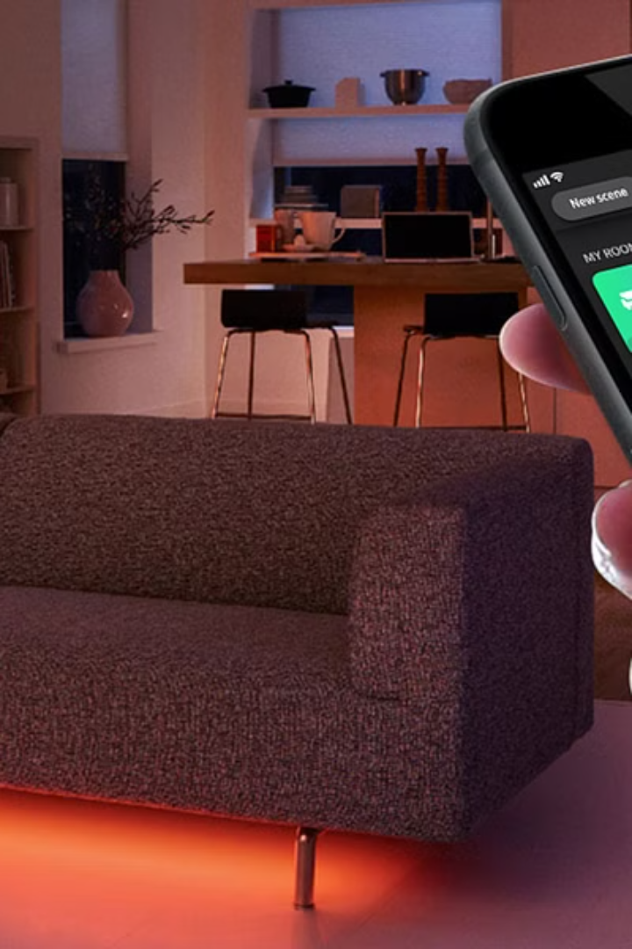
EcoSense :
Illuminating classrooms responsibly

Slide 3


Integrating Voice Assistant
Customized Voice Assistant for each room, that will handle entire regions.
Control of entire regions (in this case, rows) will be achieved through a single voice command.

Slide 4
Tech Stack
Software :
Language — Python
Application — PyCharm
Libraries & Modules — speech_recognition — google speech recognition
— pyttsx3
Hardware :
MCU — ESP8266
Language — Python
Libraries & Modules — threading — timer
— pyfirmata2 — Arduino, util

Slide 5
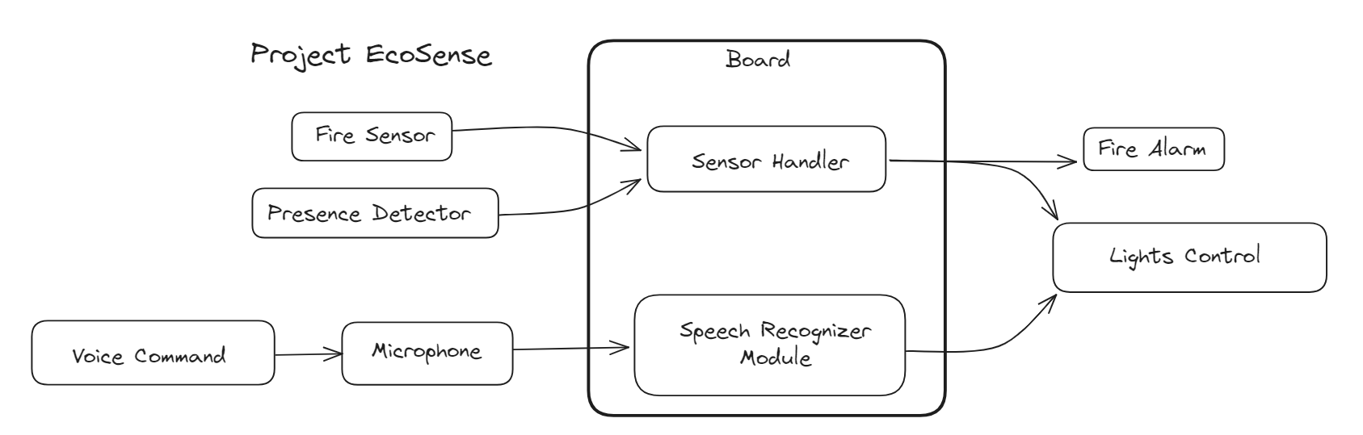
System Architecture

Slide 6
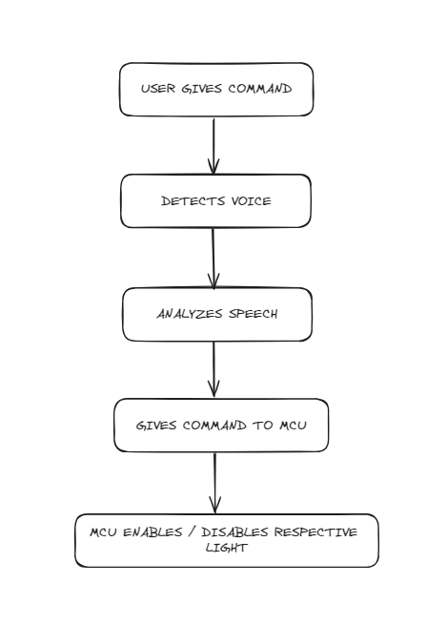
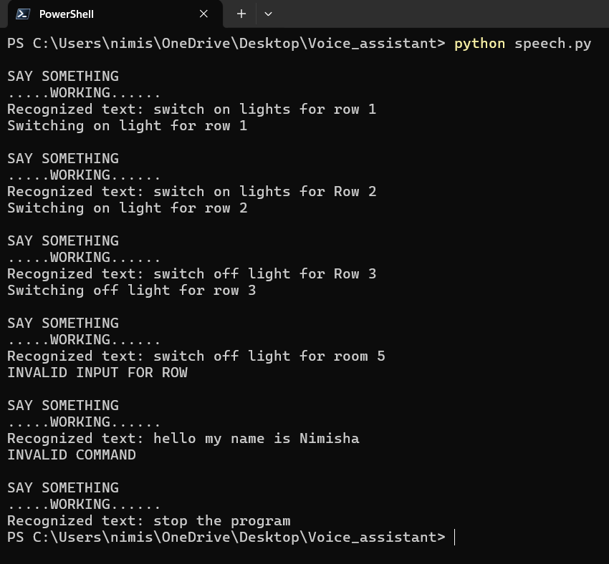

Slide 7

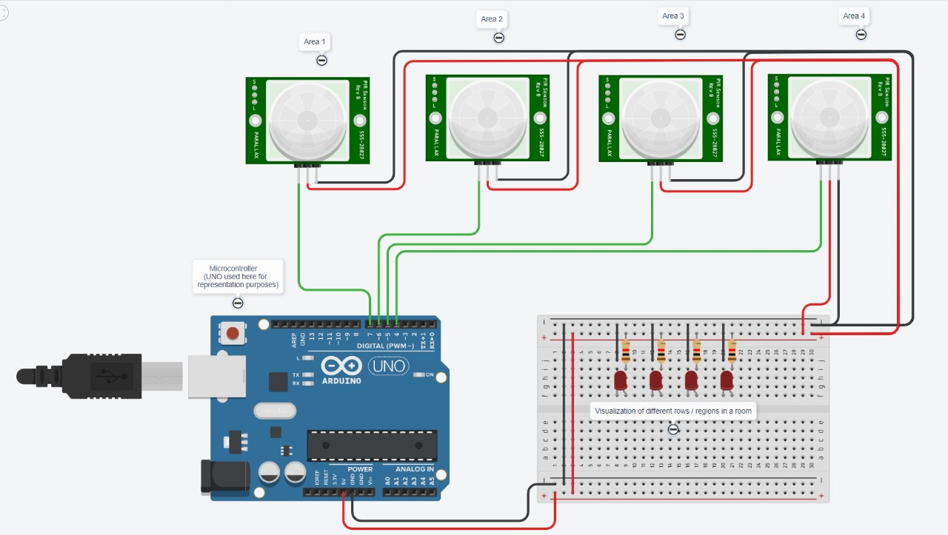
Circuit Diagram

Slide 8
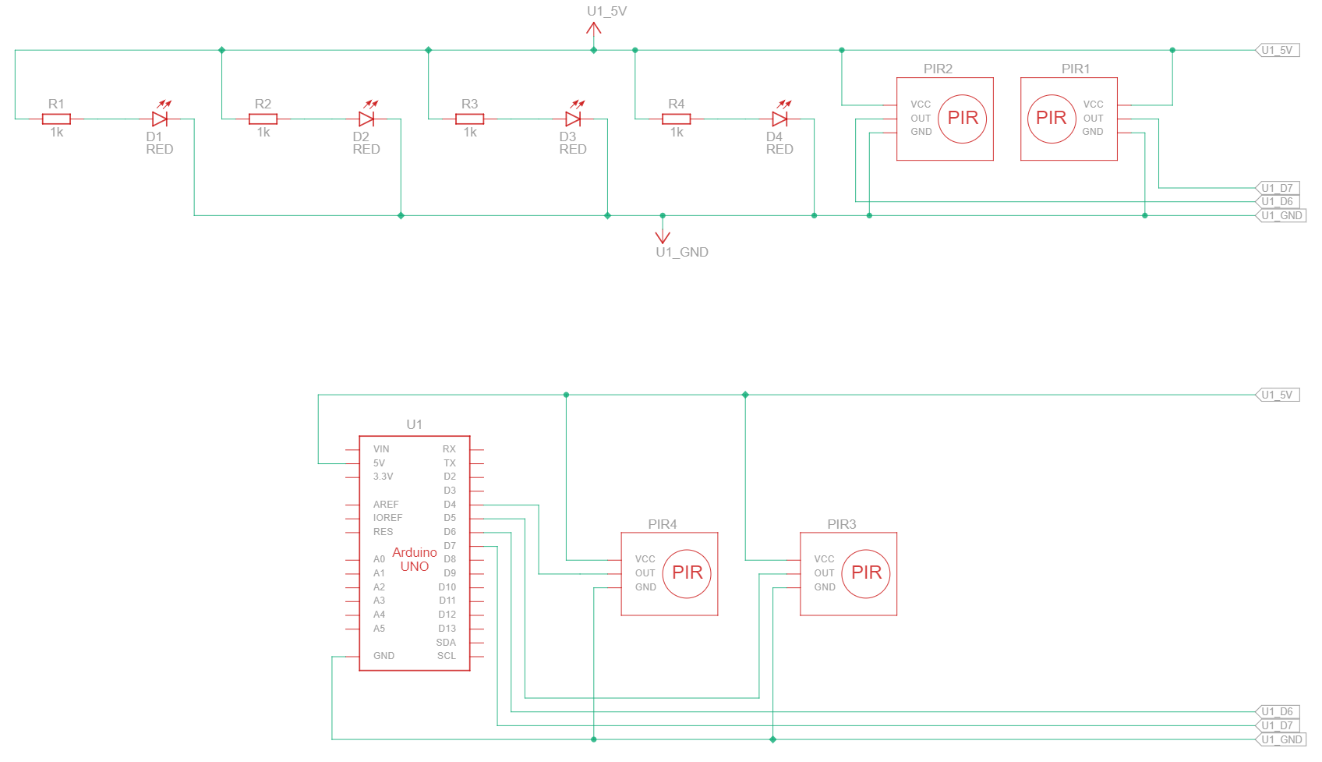
Logic Diagram

Slide 9
Component | Price | Quantity | Total
ESP8266 | 160 | 1 | 160
Relay module | 300 | 1 | 300
PIR (Passive Infrared) Sensors | 60 | 4 | 240
Buzzer | 30 | 1 | 30
IR sensor | 30 | 1 | 30
Project Board | 60 | 1 | 60
USB-Micro USB Cable | 20 | 1 | 20
 |  |  | 840

Slide 10
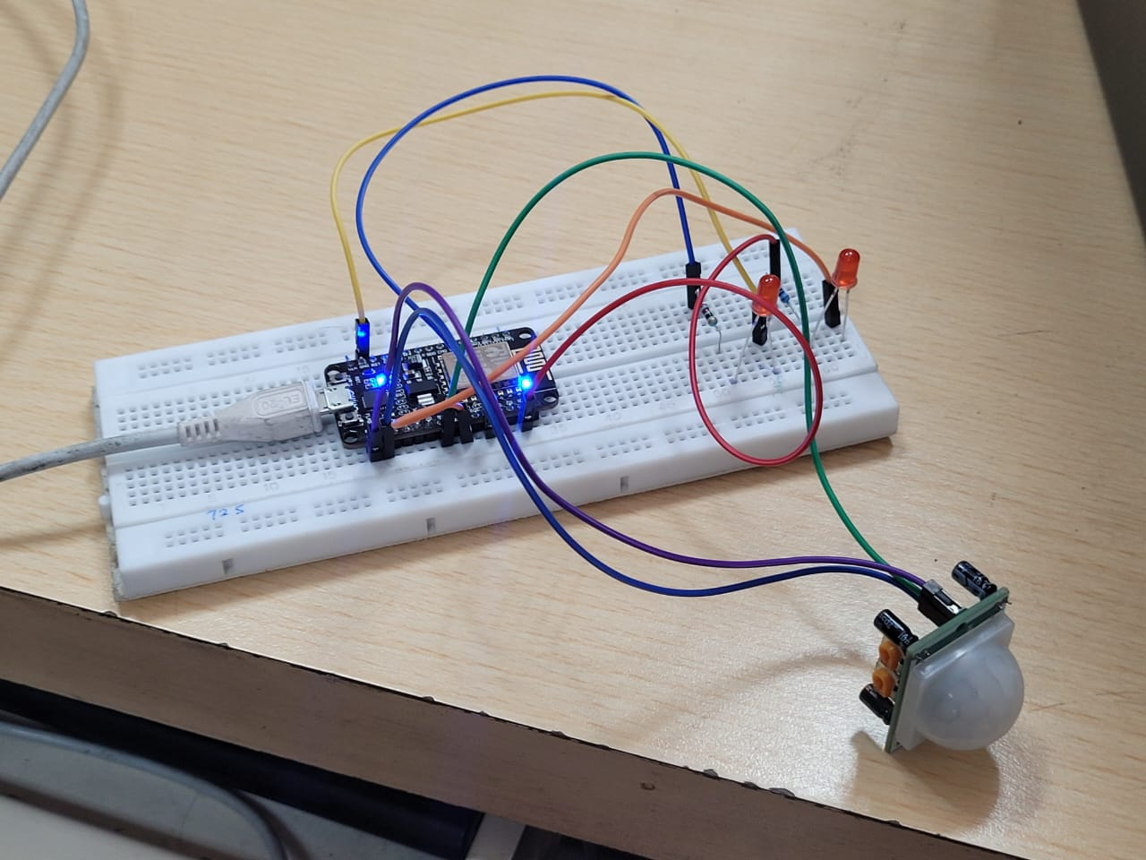
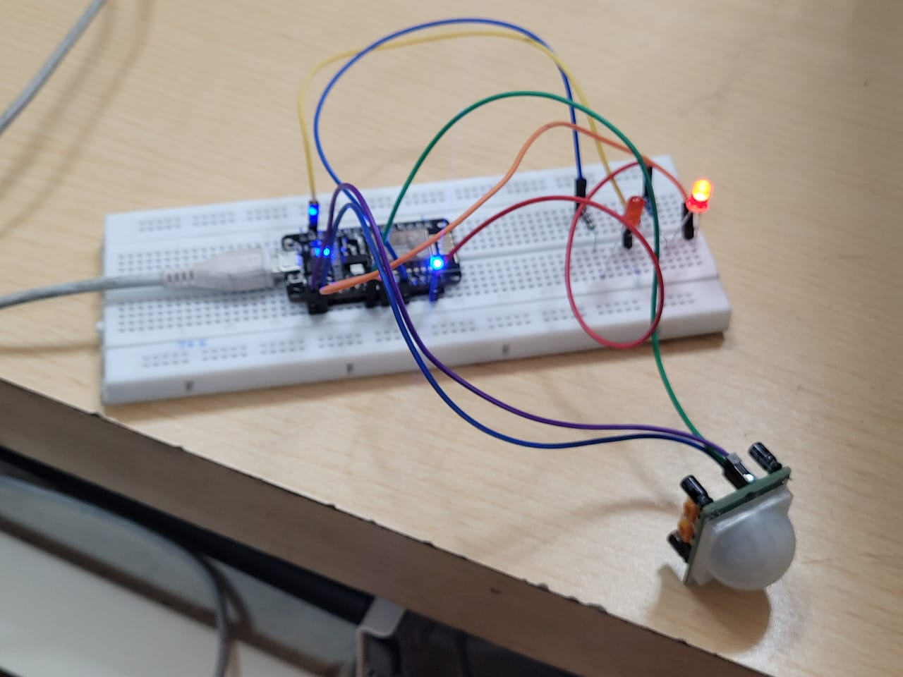
All lights off
Specific light on

Slide 11
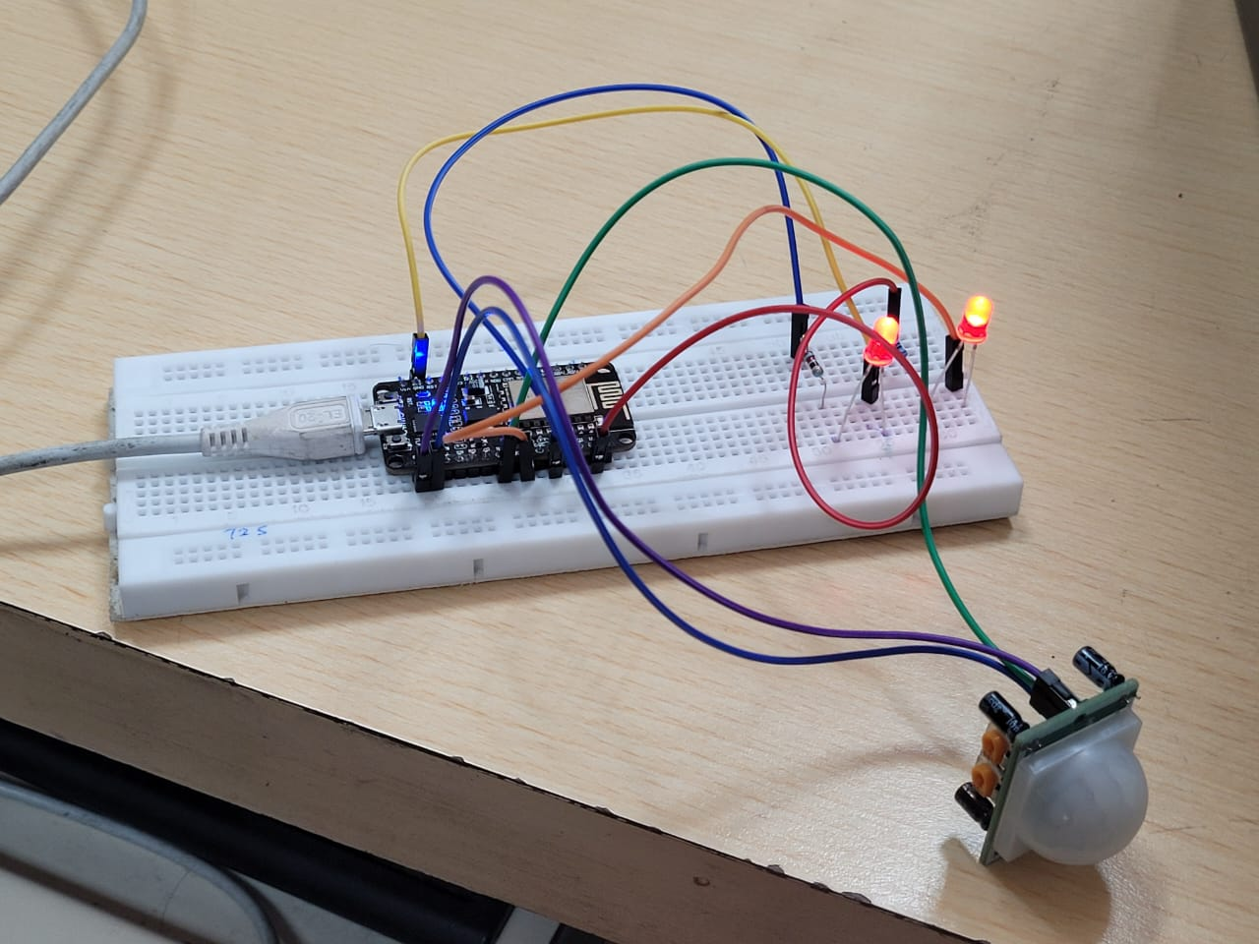
All lights on

Slide 12
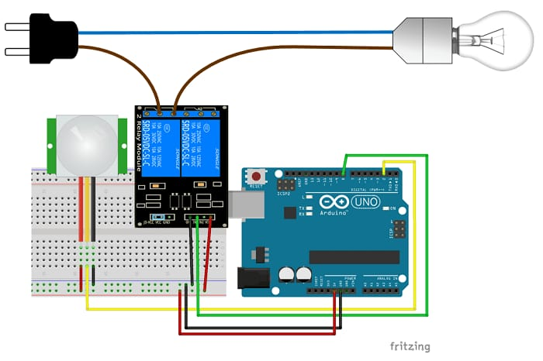

Slide 13

Thank you…!!

